Slide 1
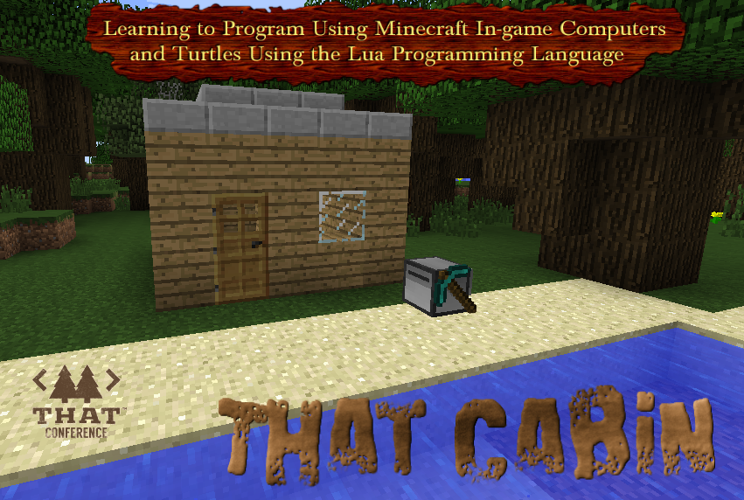
Notes:
Have slide up until presentation starts.
Today we are going to write a program to build That Cabin at That Conference in 7 easy steps.
Feel free to ask questions at any time.
We have a lot of ground to cover in the next hour.
There are handouts on the Lua language, Turtle API, Setup and Step by Step Instructions.

Slide 2


Slide 3


Slide 4

About Rebecca
I am a high school student going into 11th grade at Kettle Moraine High School in Wisconsin. I'm 17 years old. I am taking programming courses in high school that are helping me follow my dream becoming a computer programmer. I have been attending That Conference since the beginning and I have enjoyed every year of it. I ride horses and I spend my weekends volunteering at the barn.
Notes:
Programming Languages I have used so far are Lua, Python, PHP, Javascript, HTML, CSS, and Java.
Skip horse stuff.

Slide 5
Today we will be using the Minecraft Mod: ComputerCraft
Requirements: Minecraft Installed, Can Login into Minecraft Account, TechnicPack.net Launcher, Pastebin (Account is optional)
Notes:
How many of you are familiar with ComputerCraft?
How many of you are familiar with the Lua programing language?
Feel free to work ahead editing your own pastebin code or use my pastebin code links to follow along.
All the information you will need to get started is on the provided cheatsheets.
Let’s get Started.

Slide 6
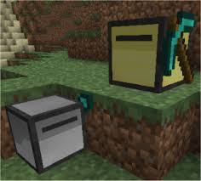
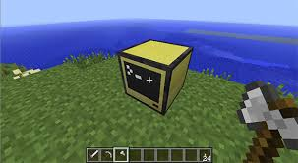
Computer Craft
Computer Craft is a mod on Minecraft that allows the user to create and program Computers, Robots called Turtles, and use the programming language Lua.
Turtles run the TurtleOS operating system. They have the ability to use tools, place, break and detect blocks, move around and drop items in their inventory via their access to the Turtle API.
Notes:
Why do you need Computer Craft?
Are you bored with plain old vanilla Minecraft?
Would it be awesome to be free do to the fun things instead of boring repetitive tasks in Minecraft.
Does anyone have an example of a boring repetitive task?
ComputerCraft is the solution for YOU!
You can automate almost anything in minecraft.
For example you could have your turtle mine minerals for you, you can have your turtle do your farming, and build things for you.
The possibilities are limitless.

Slide 7


Notes:
Before you can command your turtle to do your bidding we need to learn about Lua and some of the Turtle API Commands.
Next we will cover some of the most common Lua language features that we will use in our turtle program today.
This is not a complete list of lua commands, just what we will need today.

Slide 8
Global Variables
Variables that are available anywhere after they are created
num = 42 -- A number.
s = 'A String' -- A string.
b = true -- boolean (true/false) value.
t = nil -- Un-defines a variable to be garbage collected.
(Yes, even programming languages have to take out the garbage.)
Notes:
Explain the best practice is not to use global variables and instead use local variables.
Why is that bad? Unexpected values in your variables will cause bugs in your code.
Just assign a number, string, or boolean to a variable name of your choosing.
Create a global variable and name it, use an equal sign to assign a value to the variable.
Variable that are no longer referenced are garbage collected. That mean they are removed from the computer's memory.
I am sorry to say that programming languages do not yet have the ability to take your garbage out for you.

Slide 9
Local Variables
Variables that are only available where they are created. This means they are only available inside an if condition, function, while loop, and etc.
local num = 42 -- A number.
local s = 'A String' -- A string.
local b = true -- boolean (true/false) value.
local t = nil -- Not really needed because local variables
are automatically garbage collected.
(Just add the word local in front of variable)
Notes:
Local variables are automatically garbage collected when the function, loop, or if condition is no longer the active code running.
Unless your logic needs it the nil value is not needed.
Otherwise local variables operate the same as global variables.

Slide 10
Commenting
Text that will not be executed as code.
--[[
Presentation: LEARNING TO PROGRAM USING MINECRAFT IN-GAME
COMPUTERS AND TURTLES USING THE LUA PROGRAMMING LANGUAGE
--]]
-- Step 1: BEGIN
-- Description: Place One Block
Notes:
Explain single line comment
Explain multiple line comment block
The Single line comment can be used anywhere on a line even after command and the command will still run.
Why use one over the other… comment 1 line or multiple.

Slide 11
If Conditions
If conditions are used to ask if certain information is true and do something based on that information.
if i % 2 == 0 then
turtle.turnRight()
else
turtle.turnLeft()
end
Other operators: < > <= >= == Special Note: ~= is Not Equal
Notes:
Make sure to remember to use a double equal sign in the IF statement and why.
Talk about ~= is not equal operator.
The then and End required.
Each command should be on its own line and best practice is to indent your code for readability.

Slide 12
For loops
Used to repeat a section of code an exact number of times.
for i = 1, 4 do
build_block_wall(wall_length)
turtle.turnLeft()
end
Notes:
All the same IF operators apply to a For loop.
The Do and end is required.
Does anyone notice anything weird about the for loop? Parents who programming do you know?
Lua is one of only a few programming languages that loops and arrays start with the value 1 instead of Zero.

Slide 13
Arrays
A data structure that contains a group of items. In lua all arrays starting index is the value 1 instead of a starting index of 0 like a lot of other programing languages.
a={} --new array
for i=1, 1000 do
a[i] = 0 -- sets all values in the array to 0
end
print(a[1]) -- gets the array item’s value (Arrays also start with the value 1 instead of 0)
Notes:
Lua is one of only a few programming languages that arrays also start with the value 1 instead of Zero.
Use the brackets to assign a value to an item in the array.

Slide 14
Functions
Functions are self contained lines of code that can be called many times.
function place_block_down(inventory_name)
local inventory_slot = find_block_slot(inventory_name)
turtle.select(inventory_slot)
turtle.placeDown()
return true
End
result = place_block_down("minecraft:planks")
place_block_down("minecraft:glass")
Notes:
Functions can be run multiple times.
Functions can return a value that can be stored in a variable.
Functions can have more values passed into them.

Slide 15
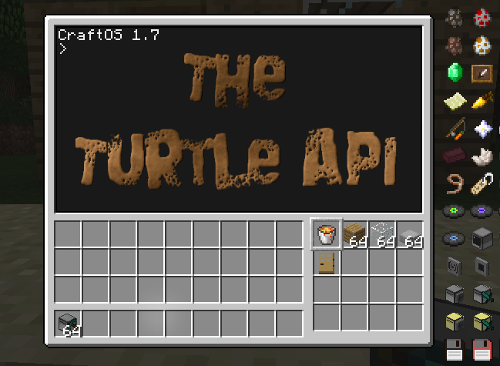
Notes:
Now onto the ComputerCraft turtle specific stuff. After right clicking on the Turtle
Your Minecraft Inventory is on the bottom left.
The Turtles Inventory is on the bottom right.
The items we have in the turtle is the items that will be needed to build your own That Cabin.
Turtles need fuel to move, lava bucket, coal, wood, or etc
Programs stored in the turtle’s memory and will stay there until the turtle is broken..

Slide 16
Turtle API Movement Commands
Commands the turtle will execute.
turtle.forward() -- tells the turtle to move forward.
turtle.up() -- tells the turtle to move up
turtle.down() -- tells the turtle to move down
turtle.turnLeft() -- tells the turtle to turn left
turtle.turnRight() -- tells the turtle to turn right
(Just what we need, there are more)
Notes:
Turtles need Fuel to Move….

Slide 17
Turtle API Inventory Commands
Commands the turtle will execute.
turtle.getItemDetail() -- gets an item's number detail
turtle.select() -- selects slot number 1 - 16
turtle.refuel() -- refuels the turtle (uses lava buckets and coal)
(Just what we need, there are more)
Notes:
turtle.select() inventory slot for use in other turtle actions.
For example - turtle.refuel, turtle.place, turtle.getItemDetail, and more

Slide 18
Turtle API Action Commands
Commands the turtle will execute.
turtle.placeDown() -- places block below turtle
turtle.place() -- places block in front of turtle
turtle.dig() -- digs the block and puts it in the inventory
(Just what we need, there are more)

Slide 19
Turtle API Passing In Arguments to Your Program
function main(number_of_stories,wall_length)
validate_arguments(number_of_stories,wall_length)
build_stories(number_of_stories, wall_length)
build_roof(wall_length)
install_door(number_of_stories)
install_window()
end
local args = { ... }
main(args[1],args[2])
Notes:
The part in yellow is the part needed to pass in arguments to you program

Slide 20
Minecraft, Minecraft Mods, Tools
Minecraft must be installed -- You will need minecraft to create your own that cabin Technicpack : is a platform where you can create and share minecraft mods in minutes Pastebin : is required to edit your Lua programs and easier than typing into your turtle directly. -- Computercraft has built in integration with pastebin -- Turtle: pastebin get dzwc8Vu0 buildCabin -- Pastebin: https://pastebin.com/u/rvonruden
Visual Studio Code : is an option to edit your Lua programs, still need Pastebin.
Notes:
We will use TechnicPack launcher to automatically Mod your Minecraft.
We will use PasteBin to Edit your Turtle Lua programs.
We will use Turtle API to import your PasteBin Lua Programs and run them.

Slide 21
Technicpack and What is IT?
Technicpack is a platform where you can put together a collection of hand-picked minecraft mods which allows the launcher to automatically mod your local minecraft in minutes.
That Minecraft 2017 : My Computercraft Technicpack for That Conference
https://www.technicpack.net/modpack/that-minecraft.1012241
You will need to download launcher : https://www.technicpack.net/download
More on using TechnicPack.net Launcher is on the next slide.
Notes:
Next, I will show you how to get started and search for the modpack inside the technicpack.Net Launcher application.

Slide 22
TechnicPack - In Minecraft all steps side by side
Download launcher and run it: https://www.technicpack.net/download
The launcher will need you to log into your MineCraft account.
Depending on your computer download Java JDK. (search google for Java JDK)
Verify the launcher’s options has the JAVA memory set to 1 GB
Search for the ModPack: That Minecraft 2017 and install the ModPack
Click the play Mod button bottom right and choose Single player game in Creative Mode.
Notes:
There is also a server version of the Modpack is also available so that you can host your own ComputerCraft World for other to play together with you.
If Minecraft is jerky then you will need to increase the amount of memory that minecraft is allowed to use… See me after the talk to update your Java Settings

Slide 23
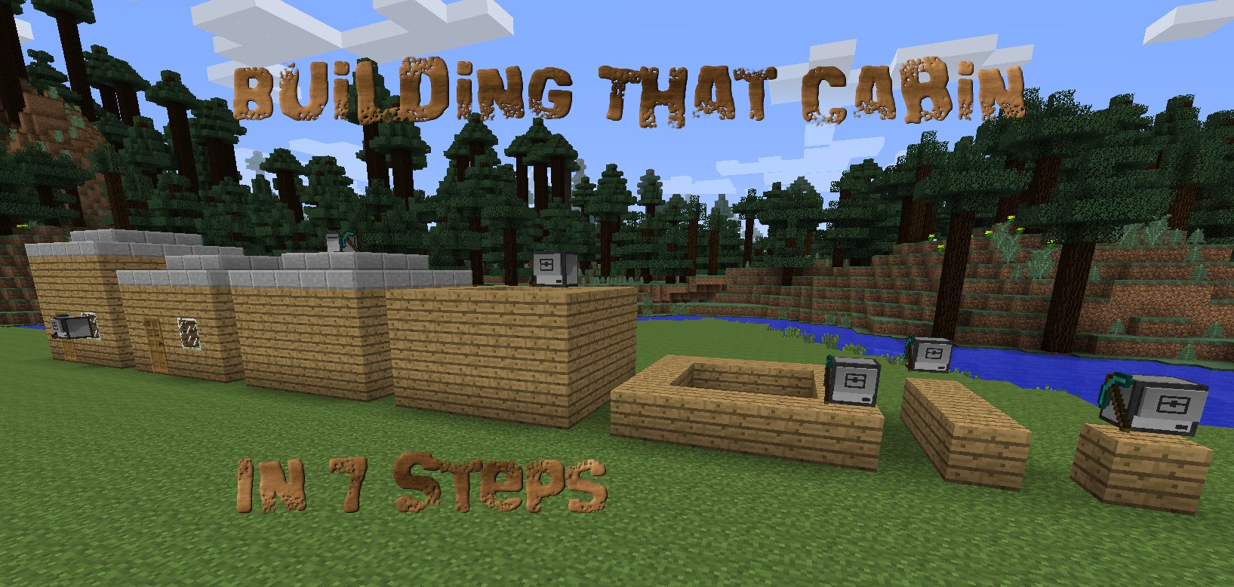
Notes:
** Explain Each Step ** Place Block Down, Build 1 wall, etc
We are going to build a Cabin 3 blocks tall and 5 blocks wide with a roof, a door and a window.
If someone asks the 7th step is not show in the screenshot and the end result of Step 7 looks the same as step 6.

Slide 24
Step 1: Place One Block Down
You will need: Mining Turtle, Lava Bucket, and Oak Wood Planks
Requirements:
Place items in “Mining Turtle” with Lava Bucket in inventory slot 1.
Refuel Turtle using inventory slot 1 and rest of the items anywhere.
Function to Find Block’s Slot in the Turtle’s inventory.
Function to Place Block Down.
Solution: In the Turtle “pastebin get vUw4CqrL step1” <enter> step1 <enter>
Notes:
Can use your own pastebin as guest or logged in account.
Turtle must be 1 block in the air.
Call main() to run functions after you define it.
Do not worry if you missed the pastebin codes because they are on your cheat sheet.
E is for Inventory in Turtle.
** Remember If condition explain if turtle inventory has an item named planks. **

Slide 25
Step 2: Build Block Wall
You will need: Mining Turtle, Lava Bucket, and Oak Wood Planks
Requirements:
Complete the the requirements for Step 1.
Create function build_block_wall(number_of_blocks).
Using a for loop to place down 4 blocks down in a row using place_block_down().
Solution: In the Turtle “pastebin get ZryCakMb step2” <enter> step2 <enter>
Notes:
Turtle must be 1 block in the air.
The pastebin code for Step 2 includes the Step 1 Code so if you fall behind just use the new pastebin codes going forward.
Just explain the new blocks needed.

Slide 26
Step 3: Build One Story
You will need: Mining Turtle, Lava Bucket, and Oak Wood Planks
Requirements:
Complete the the requirements for step 1 and 2.
Create function build_story(wall_length). A wall length of 4
Using a for loop to build 4 block_walls using left turns using build_block_wall().
Solution: In the Turtle “pastebin get 0z5Rgvuh step3” <enter> step3 <enter>
Notes:
Explain Requirements.
Show and explain Pastebin.
Put Items in turtle and run the program.
Switch to back to slide for a few minutes.

Slide 27
Step 4: Build Multiple Stories
You will need: Mining Turtle, Lava Bucket, and Oak Wood Planks.
Requirements:
Complete the requirements for Step 1, 2, and 3.
Create function build_stories(number_of_stories, wall_length).
Using a for loop to build 3 stories with a wall length of 5.
Using the build_story(wall_length) function.
Solution: In the Turtle “pastebin get JD7S4JMR step4” <enter> step4 <enter>
Notes:
The - 1 in the turtle is because the turtle is already in position 1 and only needs to place 4 more blocks for the wall.

Slide 28
Step 5: Build the Roof
You will need: Mining Turtle, Lava Bucket, Oak Wood Planks, and Stone Slabs.
Requirements:
Complete the requirements for Steps 1, 2, 3, and 4.
Create a function to Place Roof Down using stone slabs.
Create a for loop and if i % 2 == 0 then to know when to turn left or right when placing the roof block down in a function.
Solution: In the Turtle “pastebin get fv432ghS step5” <enter> step5 <enter>
Notes:
What does if i % 2 == 0 mean?
The % is the Modulus Operator.
It Divides the value of one expression by the value of another, and returns the remainder.
After dividing 2 / 2 there is no remainder and a zero is returned.
After dividing 3 / 2 there is a remainder of 5.

Slide 29
Step 6: Install Door and Window
You will need: Mining Turtle, Lava Bucket, Oak Wood Planks, Stone Slabs, Glass Blocks, and Oak Wood Door
Requirements:
Complete Requirements for Steps 1, 2, 3, 4, and 5.
Create a function to position turtle and Dig out wall blocks and Place the door.
Create a function to position turtle and dig out wall blocks and Place the window.
Solution: In the Turtle “pastebin get f9WLq2w7 step6” <enter> step6 <enter>
Notes:
The cabin size is still hard coded.

Slide 30
Step 7: Passing Arguments In
You will need: Mining Turtle, Lava Bucket, Oak Wood Planks, Stone Slabs, Glass Blocks, and Oak Wood Door
Requirements:
Complete requirements for Steps 1, 2, 3, 4, 5, and 6.
Update the main(number_of_stories,wall_length) function to accept 2 arguments.
Pass the arguments to the new main(args[1],args[2]) function.
Solution: In the Turtle “pastebin get ceFGB85S step7” <enter> step7 <enter>
Notes:
The cabin size is no longer hardcoded.
Show the Error Logic.
Hand out / cheatsheet reminder

Slide 31


Slide 32
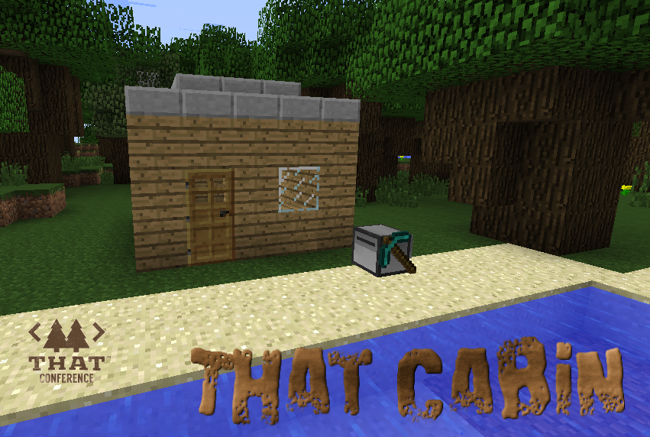
Resources and Links
Lua: en.wikipedia.org/wiki/Lua_(programming_language)Turtle MineCraft: minecraft.net/en-us/ ComputerCraft: www.computercraft.info/download/ Technic ModPack - www.technicpack.net Turtle API: computercraft.info/wiki/Turtle_(API) Solution Program and Slides: pastebin get dzwc8Vu0 buildCabin PasteBin: https://pastebin.com/u/rvonruden GitHub: https://github.com/RebeccaVonRuden/ThatConference-2017 Contact: rebecca@vonruden.info
Notes:
Thank them for attending.
Are you doing an open spaces after to help / continue?

